Slide 1

50.039 Theory and Practice of Deep Learning W9-S2 Graph Convolutional Networks
Matthieu De Mari

Slide 2
About this week (Week 9)
What are graph objects?
How do we define a graph object mathematically?
What are typical graph problems?
How can we embed a graph object to later feed it to a Neural Network?
What is a graph convolution and how des it relate to the concept of image convolution?
What are more advanced problems and approaches on graph convolutional Neural Networks?

Slide 3
Outline
In this lecture
Using graph types datasets
Graph convolutions and graph embeddings
How these convolutions relate to images
Graph Convolutional Neural Networks
In the next lectures
Some more advanced graph embeddings techniques

Slide 4


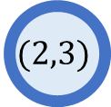
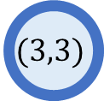
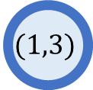
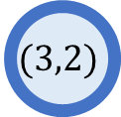
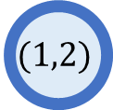
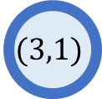
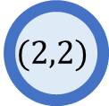
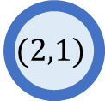
Learning from CNNs: images are graphs?
Previous lecture: recognizing graph structures.
Consider an image (greyscale, for simplicity).
It is a graph!
Nodes are pixels,
Nodes features are pixel values,
Edges connect neighboring pixels,
Edges are arranged in a regular grid.
$$(1,1)$$
$$(1,2)$$
$$(1,3)$$
$$(2,1)$$
$$(2,2)$$
$$(2,3)$$
$$(3,1)$$
$$(3,2)$$
$$(3,3)$$

Slide 5
Learning from CNNs: the need for convolutional operations
Lessons from the CNNs lectures:
Keeping the structure of the image is essential: flattening an image and using Dense/FC layers does not work well.
Reason: pixel values taken independently have little to no meaning.
Lesson: the structure of the image matters!
CNN solution: use convolutional operations, which help identify structural elements in the image.

Slide 6
Learning from CNNs: the need for convolutional operations
For graphs, same idea: nodes on their own have little meaning, the graph structure matters.
Observation (Homophily property of graphs): Connected nodes in a graph tend to have similar features and labels.

Slide 7
Learning from CNNs: the need for convolutional operations
For graphs, same idea: nodes on their own have little meaning, the graph structure matters.
Observation (Homophily property of graphs): Connected nodes in a graph tend to have similar features and labels.
This observation holds for images!
Connected pixels often have close values/colors and belong to the same type of object in the image.
Convolution allows to identify parts of the image where the homophily property does not hold.
(drastic shifts in pixel color/values = edges and corners)

Slide 8
Learning from CNNs: the need for convolutional operations
For graphs, same idea: nodes on their own have little meaning, the graph structure matters.
Observation (Homophily property of graphs): Connected nodes in a graph tend to have similar features and labels.
This observation holds for images!
Connected pixels often have close values/colors and belong to the same type of object in the image.
Convolution allows to identify parts of the image where the homophily property does not hold.
(drastic shifts in pixel color/values = edges and corners)
→ Million dollar question: what would be the equivalent of an image convolution applied to a (not necessarily regular) graph?

Slide 9
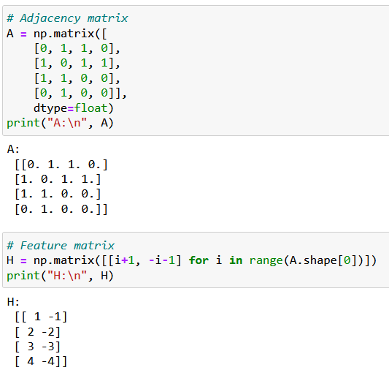
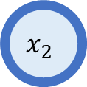
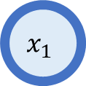
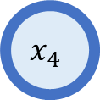
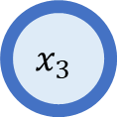
Our toy example
$$x_{2}$$
$$x_{1}$$
For demonstration purposes, let us consider the following graph.
Its adjacency matrix can then be defined as A.
$$x_{4}$$
$$x_{3}$$

Slide 10
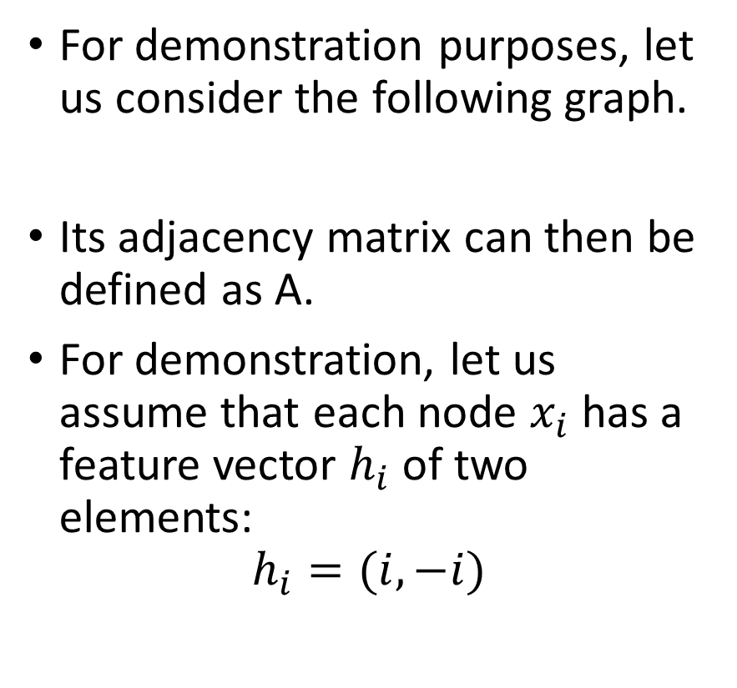
Our toy example
$$x_{2}$$
$$x_{1}$$
For demonstration purposes, let us consider the following graph.
Its adjacency matrix can then be defined as A.
For demonstration, let us assume that each node $x_{i}$has a feature vector $h_{i}$ of two elements:
$$h_{i}=(i, −i)$$
$$x_{4}$$
$$x_{3}$$

Slide 11
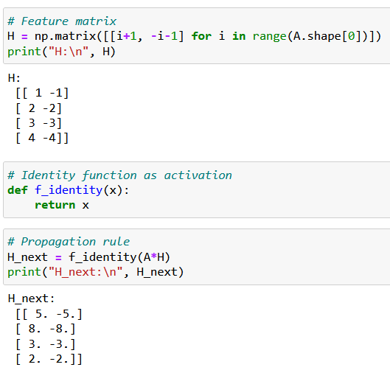

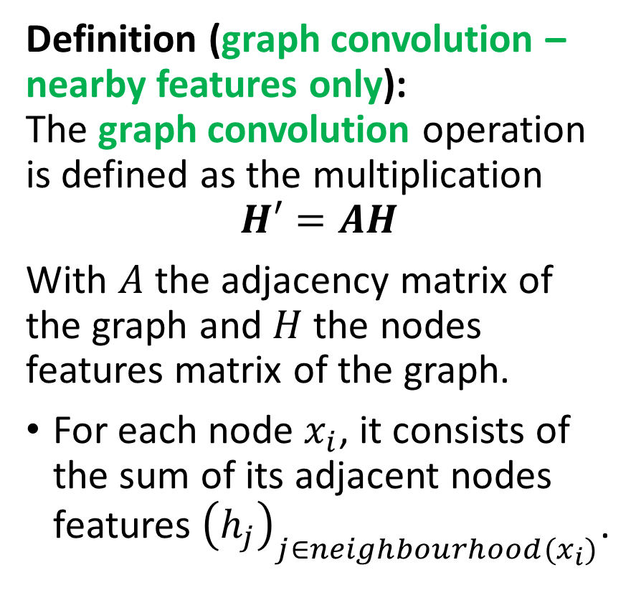
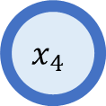
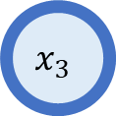
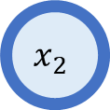
Graph Convolution #1
$$x_{2}$$
$$x_{1}$$
$$x_{4}$$
Definition (graph convolution – nearby features only): The graph convolution operation is defined as the multiplication
$$H′=AH$$
With $A$ the adjacency matrix of the graph and $H$ the nodes features matrix of the graph.
For each node $x_{i}$, it consists of the sum of its adjacent nodes features ${\left(h_{j}\right)}_{j∈neighbourhood(x_{i})}$.
$$x_{3}$$

Slide 12
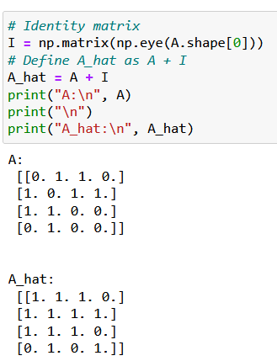
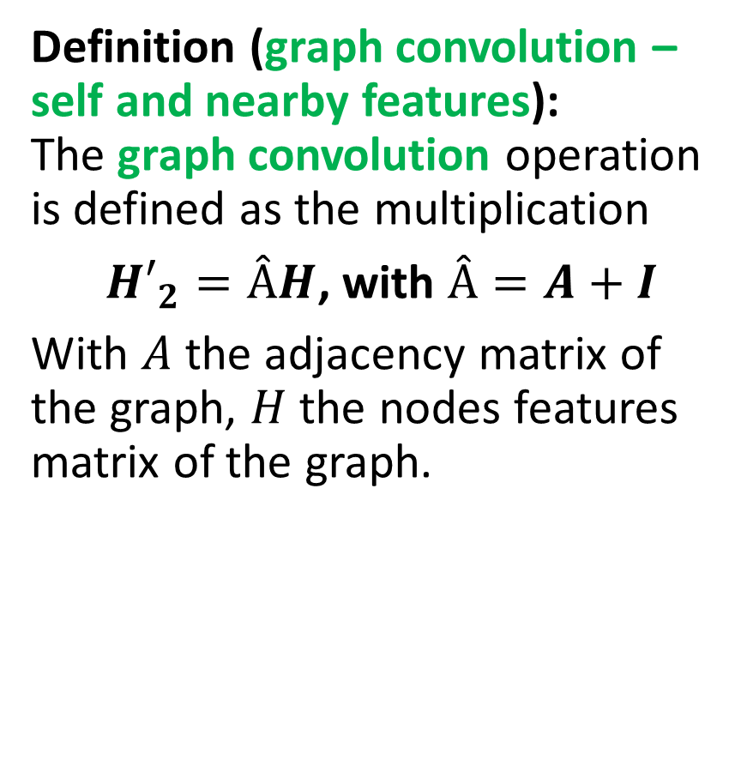
Graph Convolution #2
$$x_{2}$$
$$x_{1}$$
Definition (graph convolution – self and nearby features): The graph convolution operation is defined as the multiplication
${H′}_{2}=ÂH$, with $Â=A+I$
With $A$ the adjacency matrix of the graph, $H$ the nodes features matrix of the graph.
$$x_{4}$$
$$x_{3}$$

Slide 13
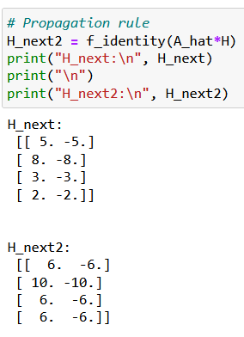
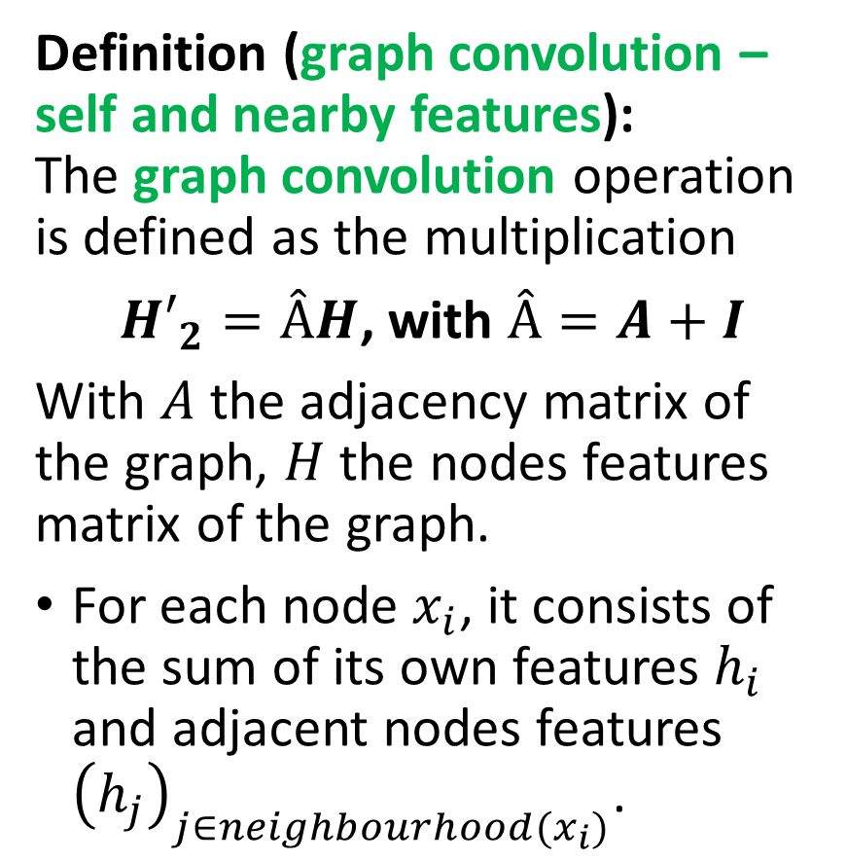
Graph Convolution #2
$$x_{2}$$
$$x_{1}$$
Definition (graph convolution – self and nearby features): The graph convolution operation is defined as the multiplication
${H′}_{2}=ÂH$, with $Â=A+I$
With $A$ the adjacency matrix of the graph, $H$ the nodes features matrix of the graph.
For each node $x_{i}$, it consists of the sum of its own features $h_{i}$ and adjacent nodes features ${\left(h_{j}\right)}_{j∈neighbourhood(x_{i})}$.
$$x_{4}$$
$$x_{3}$$

Slide 14

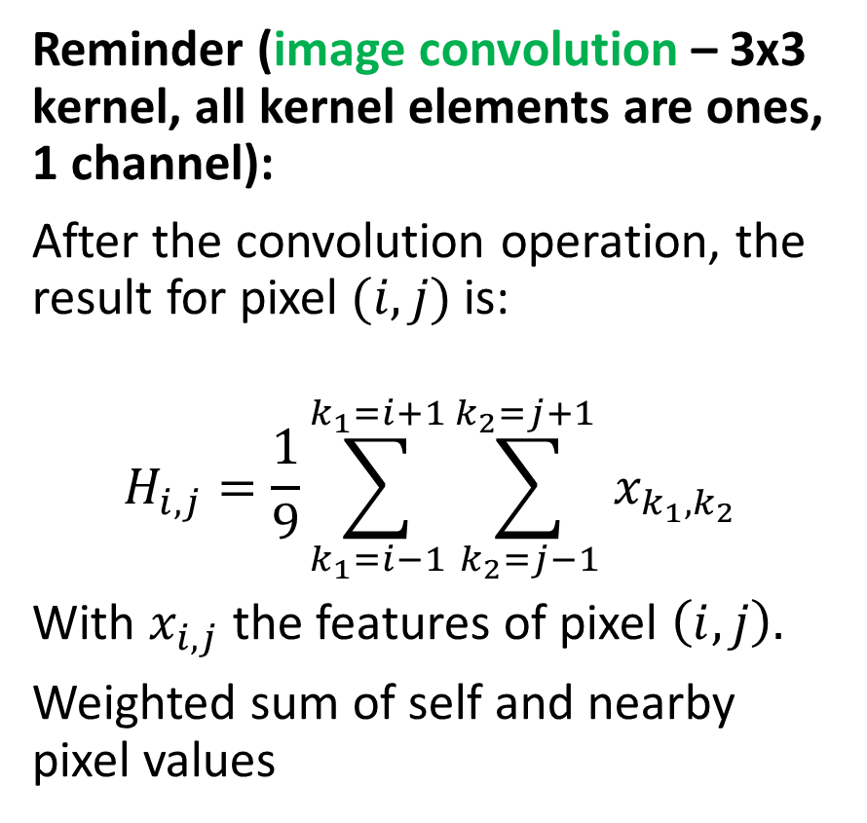
Image Convolution vs. Graph Convolution
Reminder (image convolution – 3x3 kernel, all kernel elements are ones, 1 channel):
After the convolution operation, the result for pixel $(i,j)$ is:
$$H_{i,j}=\frac{1}{9}\sum_{k_{1}=i−1}^{k_{1}=i+1}{\sum_{k_{2}=j−1}^{k_{2}=j+1 }{x_{k_{1}, k_{2}}}}$$
With $x_{i,j}$ the features of pixel $\left(i,j\right).$
Weighted sum of self and nearby pixel values
X
H

Slide 15
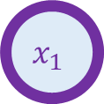
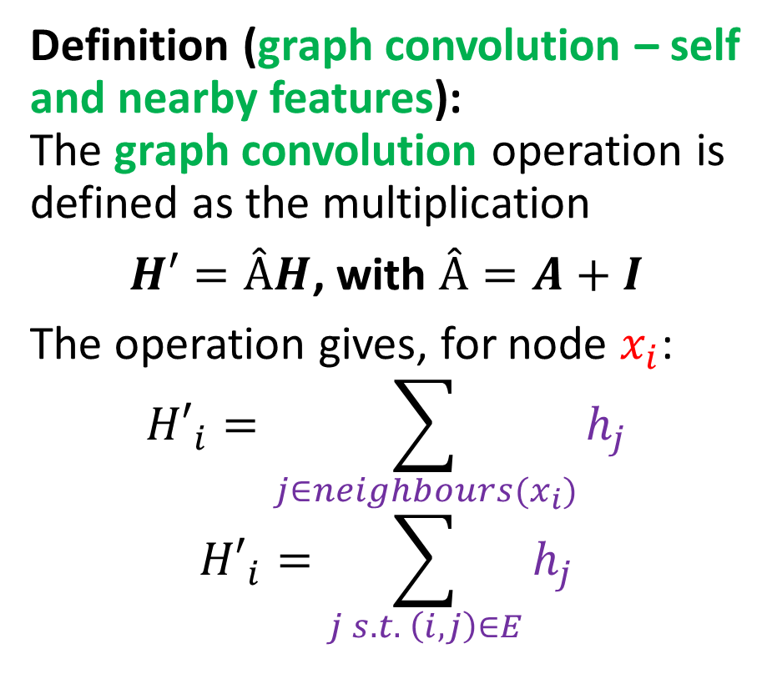
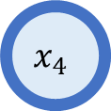
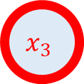
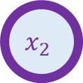
Image Convolution vs. Graph Convolution
Definition (graph convolution – self and nearby features): The graph convolution operation is defined as the multiplication
$H′=ÂH$, with $Â=A+I$
The operation gives, for node $x_{i}$:
$${H′}_{i}=\sum_{j∈neighbours(x_{i})}{h_{j}}$$
$${H′}_{i}=\sum_{j s.t. \left(i,j\right)∈E}{h_{j}}$$
$$x_{2}$$
$$x_{1}$$
$$x_{4}$$
$$x_{3}$$

Slide 16
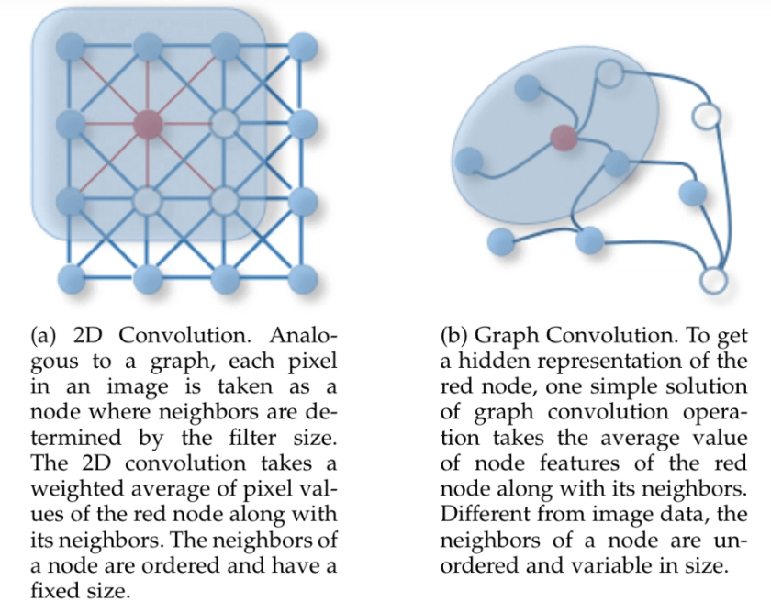
Image Convolution vs. Graph Convolution

Slide 17
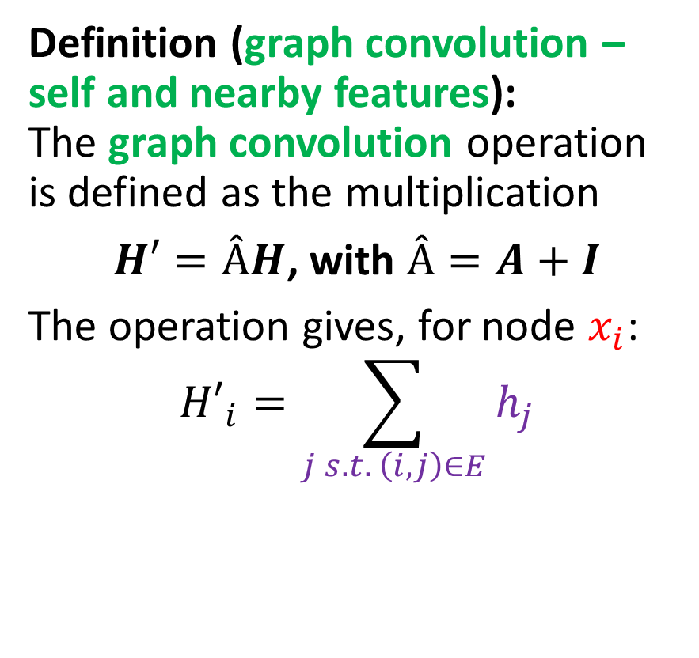
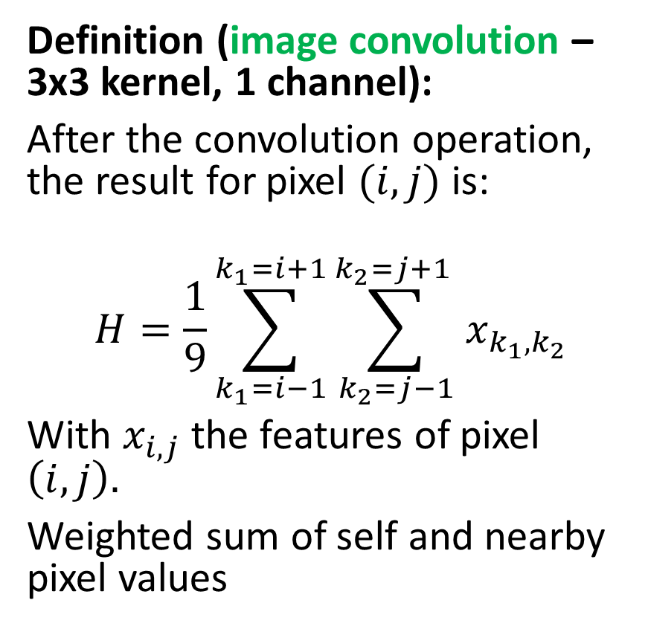
Image Convolution vs. Graph Convolution
Definition (graph convolution – self and nearby features): The graph convolution operation is defined as the multiplication
$H′=ÂH$, with $Â=A+I$
The operation gives, for node $x_{i}$:
$${H′}_{i}=\sum_{j s.t. \left(i,j\right)∈E}{h_{j}}$$
Definition (image convolution – 3x3 kernel, 1 channel):
After the convolution operation, the result for pixel $(i,j)$ is:
$$H=\frac{1}{9}\sum_{k_{1}=i−1}^{k_{1}=i+1}{\sum_{k_{2}=j−1}^{k_{2}=j+1 }{x_{k_{1}, k_{2}}}}$$
With $x_{i,j}$ the features of pixel $\left(i,j\right).$
Weighted sum of self and nearby pixel values

Slide 18
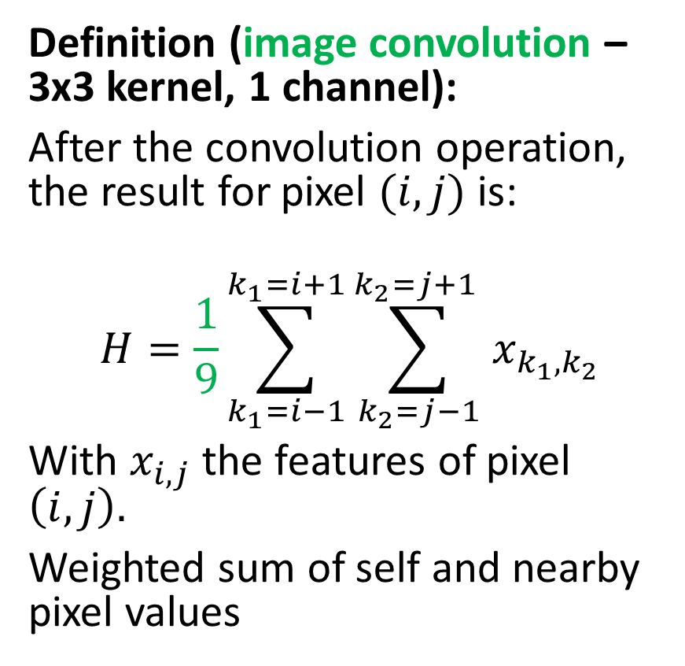
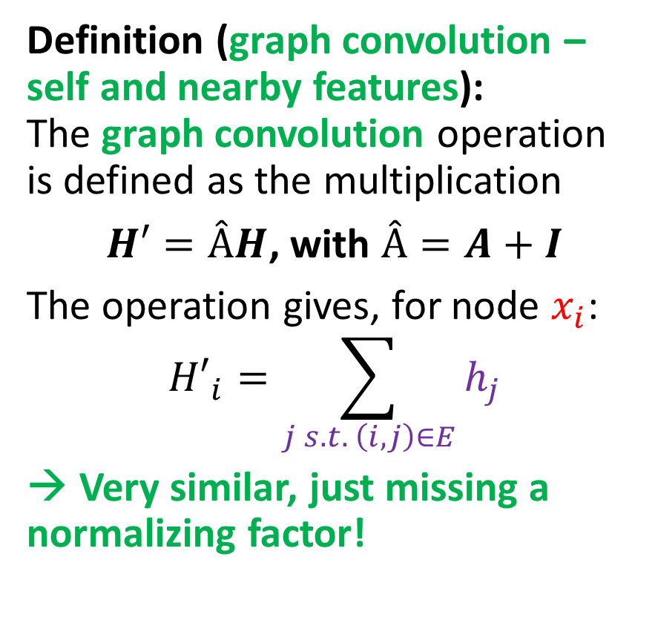
Image Convolution vs. Graph Convolution
Definition (graph convolution – self and nearby features): The graph convolution operation is defined as the multiplication
$H′=ÂH$, with $Â=A+I$
The operation gives, for node $x_{i}$:
$${H′}_{i}=\sum_{j s.t. \left(i,j\right)∈E}{h_{j}}$$
→ Very similar, just missing a normalizing factor!
Definition (image convolution – 3x3 kernel, 1 channel):
After the convolution operation, the result for pixel $(i,j)$ is:
$$H=\frac{1}{9}\sum_{k_{1}=i−1}^{k_{1}=i+1}{\sum_{k_{2}=j−1}^{k_{2}=j+1 }{x_{k_{1}, k_{2}}}}$$
With $x_{i,j}$ the features of pixel $\left(i,j\right).$
Weighted sum of self and nearby pixel values
?

Slide 19
Normalizing
$$x_{2}$$
$$x_{1}$$
$$x_{4}$$
Question: What is the name of the normalizing factor we are looking for?
$$x_{3}$$

Slide 20
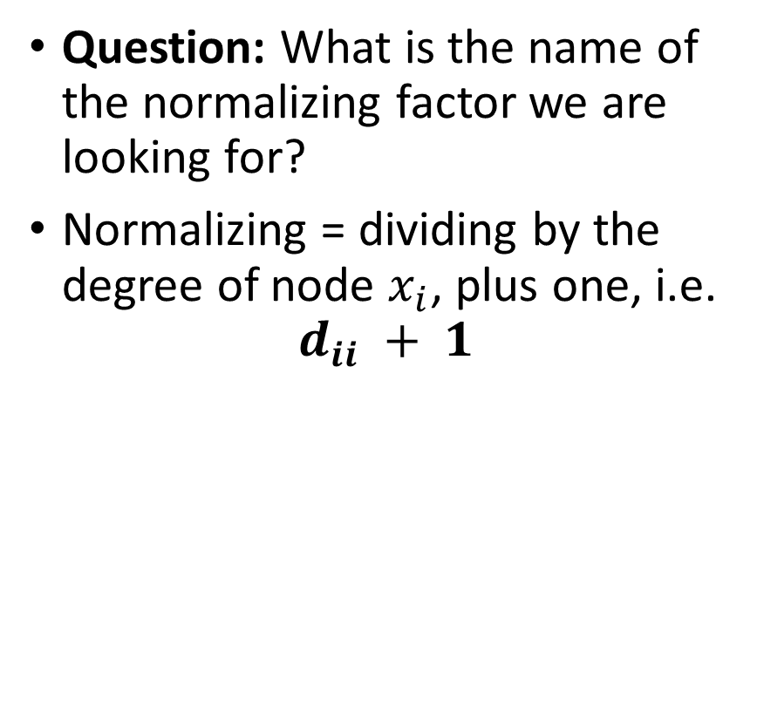
Normalizing (degrees)
$$x_{2}$$
$$x_{1}$$
$$x_{4}$$
Question: What is the name of the normalizing factor we are looking for?
Normalizing = dividing by the degree of node $x_{i}$, plus one, i.e.
$$d_{ii} + 1$$
$$x_{3}$$

Slide 21
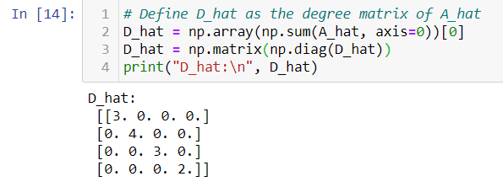
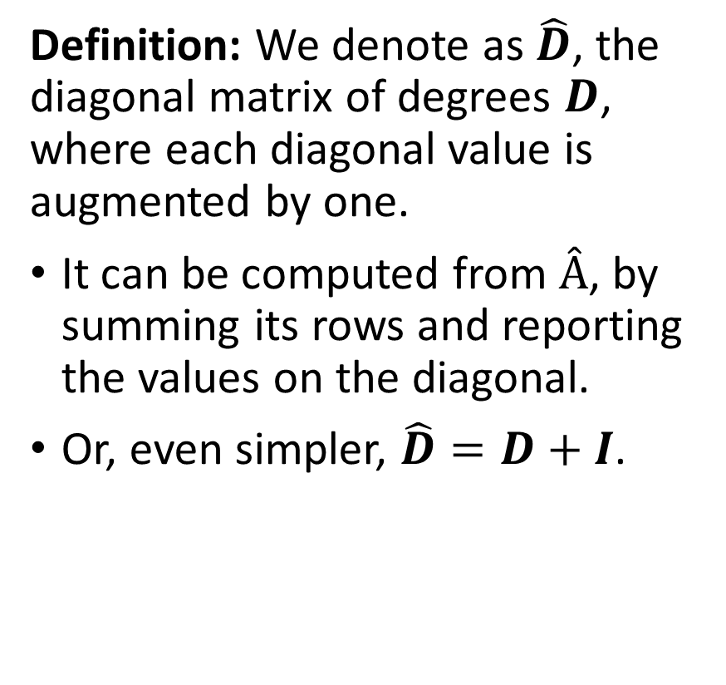
Normalizing (degrees)
$$x_{2}$$
$$x_{1}$$
$$x_{4}$$
Definition: We denote as $\hat{D}$, the diagonal matrix of degrees $D$, where each diagonal value is augmented by one.
It can be computed from $Â$, by summing its rows and reporting the values on the diagonal.
Or, even simpler, $\hat{D}=D+I$.
$$x_{3}$$

Slide 22
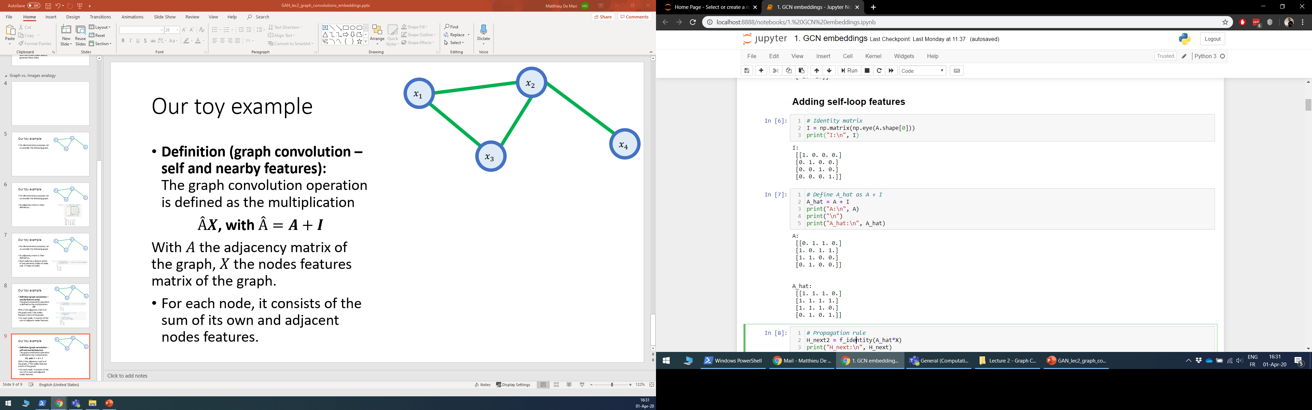
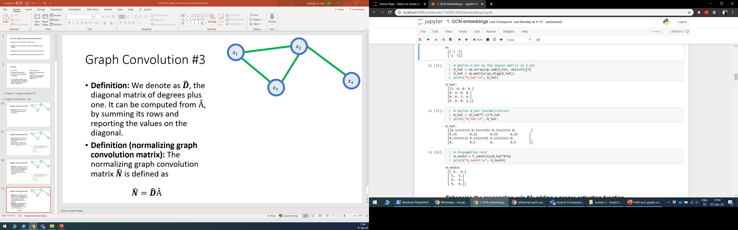
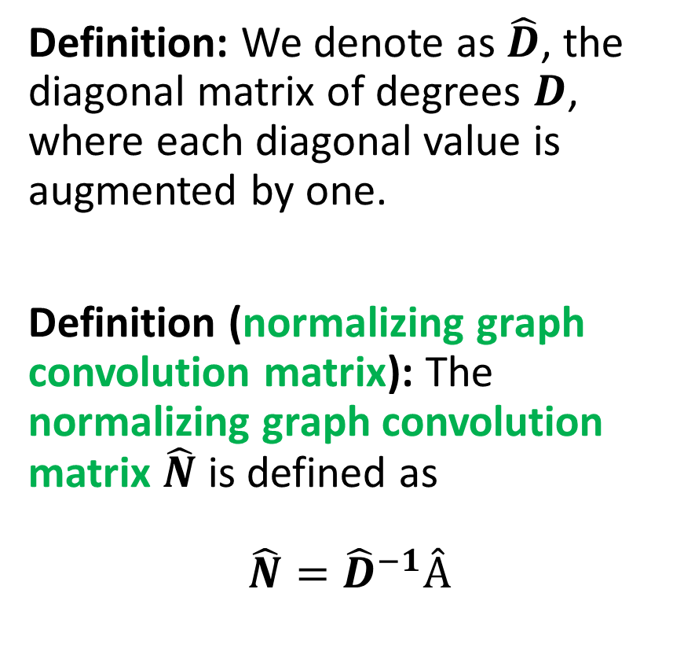
Normalizing (degrees)
$$x_{2}$$
$$x_{1}$$
$$x_{4}$$
Definition: We denote as $\hat{D}$, the diagonal matrix of degrees $D$, where each diagonal value is augmented by one.
Definition (normalizing graph convolution matrix): The normalizing graph convolution matrix $\hat{N}$ is defined as
$$\hat{N}={\hat{D}}^{−1}Â$$
$$x_{3}$$

Slide 23
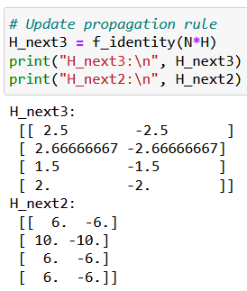
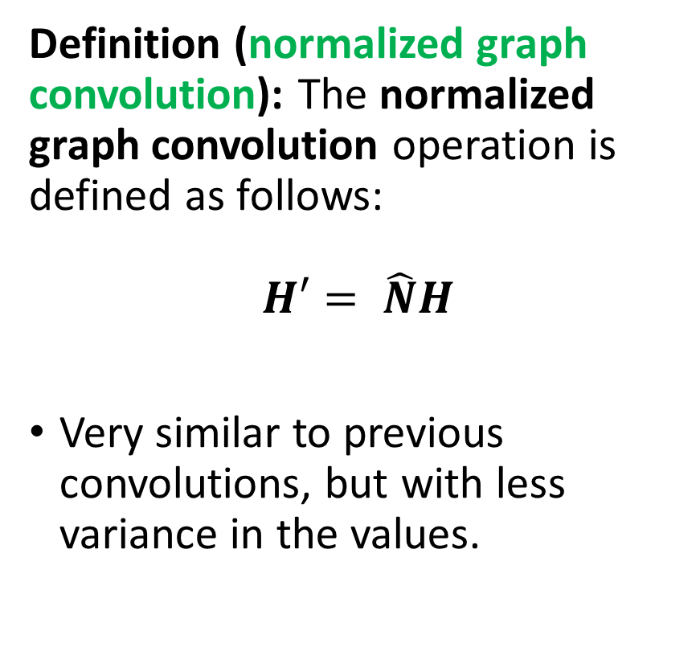
Normalizing (degrees)
$$x_{2}$$
$$x_{1}$$
$$x_{4}$$
Definition (normalized graph convolution): The normalized graph convolution operation is defined as follows:
$$H′= \hat{N}H$$
Very similar to previous convolutions, but with less variance in the values.
$$x_{3}$$

Slide 24
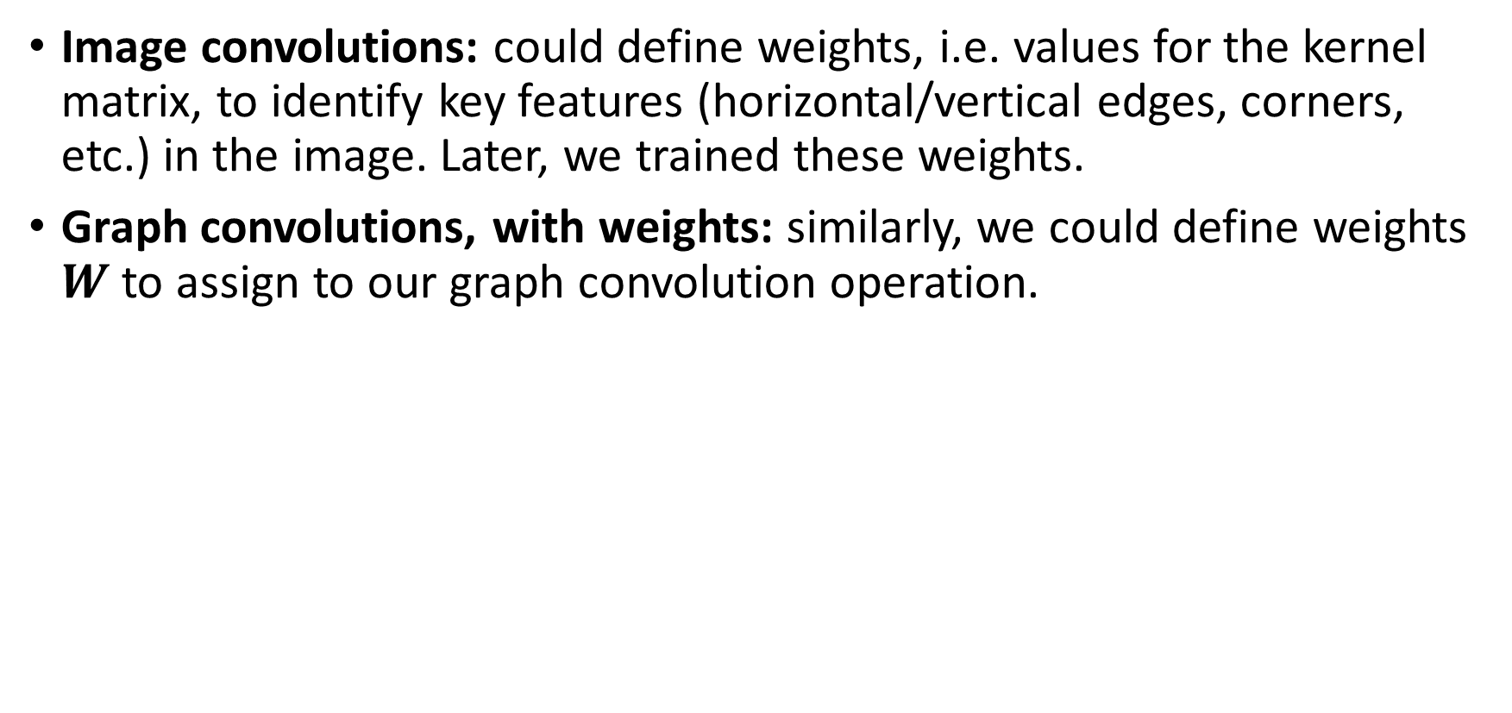
Adding weights to graph convolutions
Image convolutions: could define weights, i.e. values for the kernel matrix, to identify key features (horizontal/vertical edges, corners, etc.) in the image. Later, we trained these weights.
Graph convolutions, with weights: similarly, we could define weights $W$ to assign to our graph convolution operation.

Slide 25
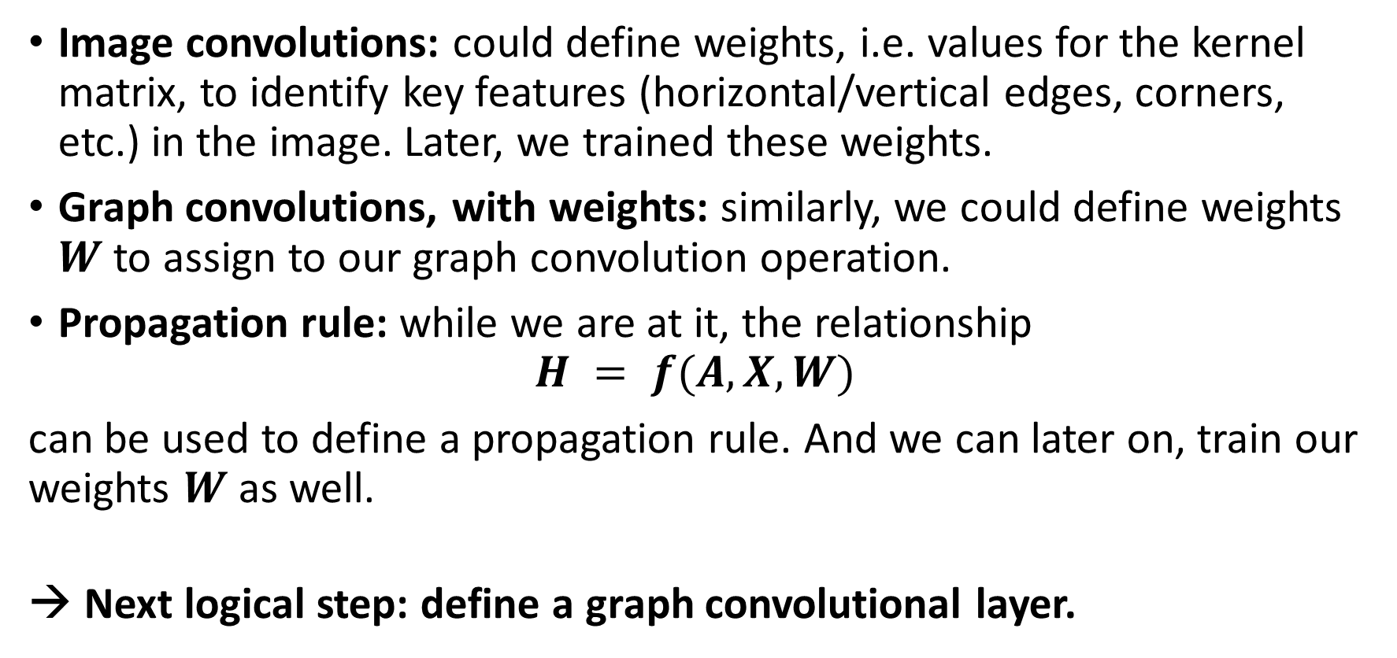
Adding weights to graph convolutions
Image convolutions: could define weights, i.e. values for the kernel matrix, to identify key features (horizontal/vertical edges, corners, etc.) in the image. Later, we trained these weights.
Graph convolutions, with weights: similarly, we could define weights $W$ to assign to our graph convolution operation.
Propagation rule: while we are at it, the relationship
$$H = f(A,X,W)$$
can be used to define a propagation rule. And we can later on, train our weights $W$as well.
→ Next logical step: define a graph convolutional layer.

Slide 26
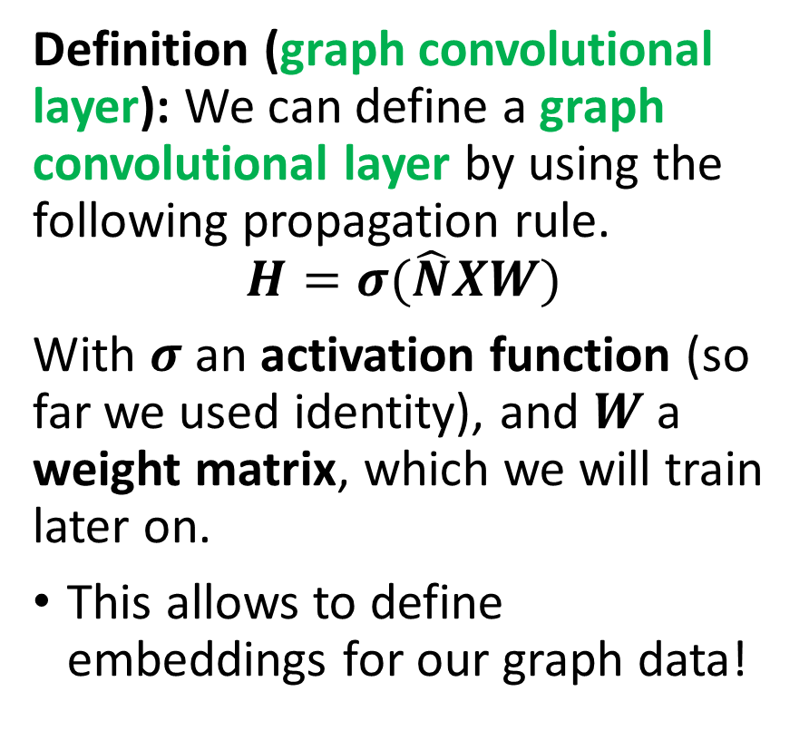
From graph convolution to graph convolutional layers
Graph data
$$(A, D, Â, \hat{D}, \hat{N}, X)$$
Graph data
(𝐴, 𝐷, Â, 𝐷 ̂, 𝑁 ̂, 𝑋)
Graph convolutional layer
$$H=σ(\hat{N}XW)$$
Graph convolutional layer
𝐻=𝜎(𝑁 ̂𝑋𝑊)
Embedding for graph data
Definition (graph convolutional layer): We can define a graph convolutional layer by using the following propagation rule.
$$H=σ(\hat{N}XW)$$
With $σ$ an activation function (so far we used identity), and $W$ a weight matrix, which we will train later on.
This allows to define embeddings for our graph data!

Slide 27
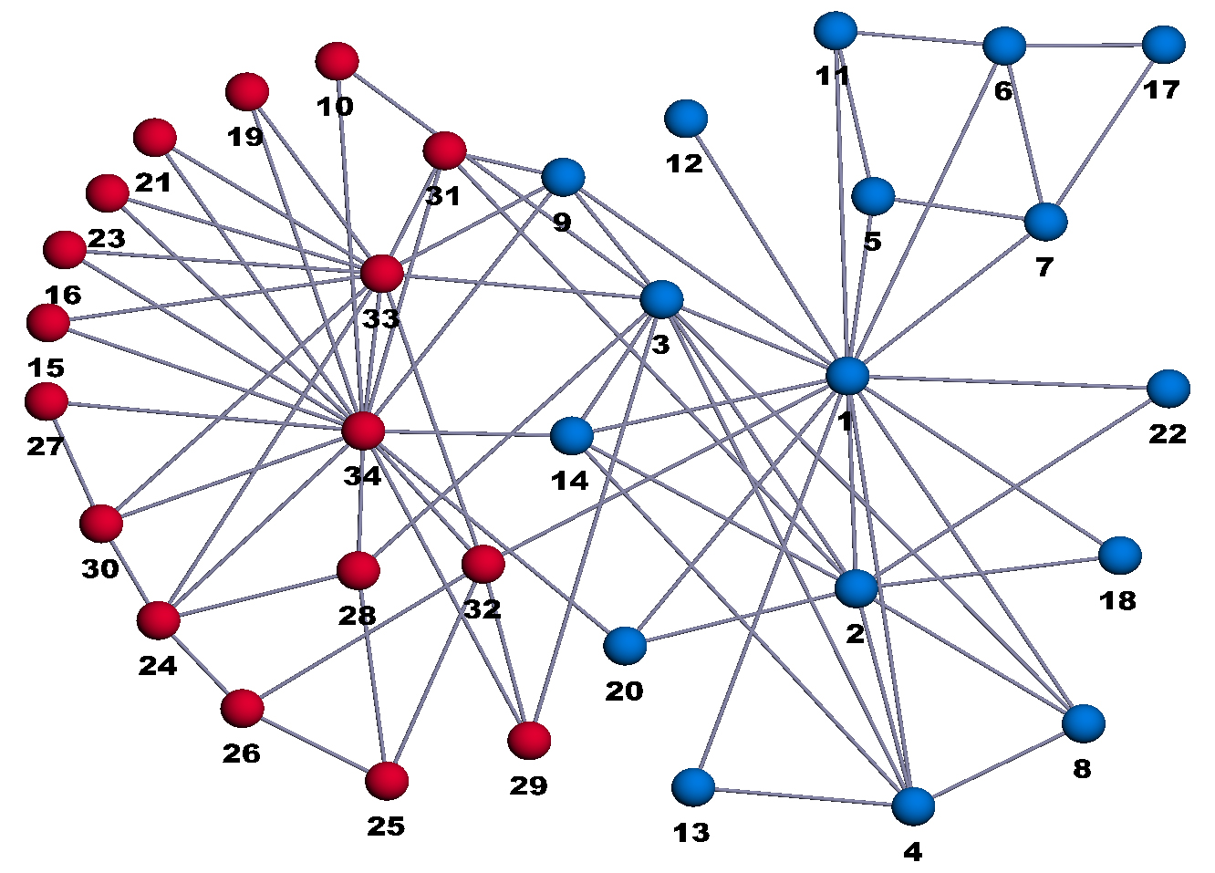
A more sophisticated toy example
Zachary Karate Fight club [ZKC]:
34 members, as nodes, indexed from 1 to 34.
Mr. Hi, the owner is node 1.
The Officer/Trainer is node 34.
All other nodes are members.
Edges define friendships between individuals.
Question: If Mr. Hi and the officer/trainer decide to fight, what will be the teams?
[ZKC] Zachary, W. W. (1977). An information flow model for conflict and fission in small groups.

Slide 28
A more sophisticated toy example
Zachary Karate Fight club [ZKC]:
It consists of a binary classification problem.
Separate the nodes (as with any classification problem).
Need an embedding to represent the graph data, as a matrix/vector of some sort.
→ Graph convolutional layer
[ZKC] Zachary, W. W. (1977). An information flow model for conflict and fission in small groups.

Slide 29
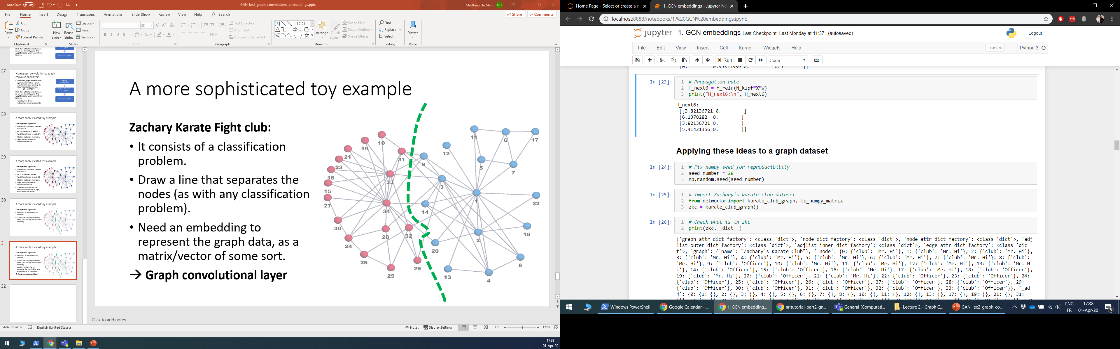
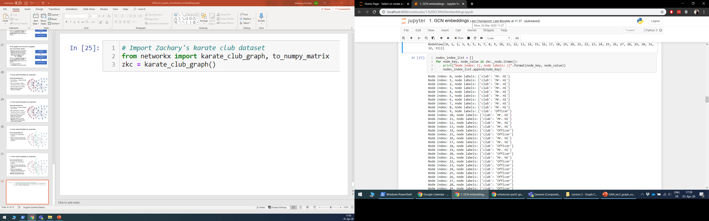

Slide 30
Spectral graph embedding
Graph data
$$(A, D, Â, \hat{D}, \hat{N}, X)$$
Graph data
(𝐴, 𝐷, Â, 𝐷 ̂, 𝑁 ̂, 𝑋)
Graph convolutional layer #1
$$H_{1}=σ(\hat{N}XW_{1})$$
Graph convolutional layer #1
𝐻_1=𝜎(𝑁 ̂𝑋𝑊_1)
Embedding $H_{2}$ for graph data
Embedding 𝐻_2 for graph data
Graph convolutional layer #2
$$H_{2}=σ(\hat{N}H_{1}W_{2})$$
Graph convolutional layer #2
𝐻_2=𝜎(𝑁 ̂𝐻_1 𝑊_2)
Our setup (Spectral graph embedding, with graph convolutional layers):
Two graph convolutional layers
ReLU as activation function
Normalized graph convolution

Slide 31
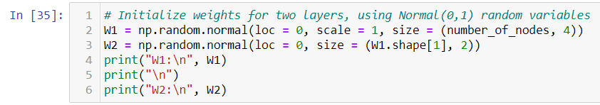
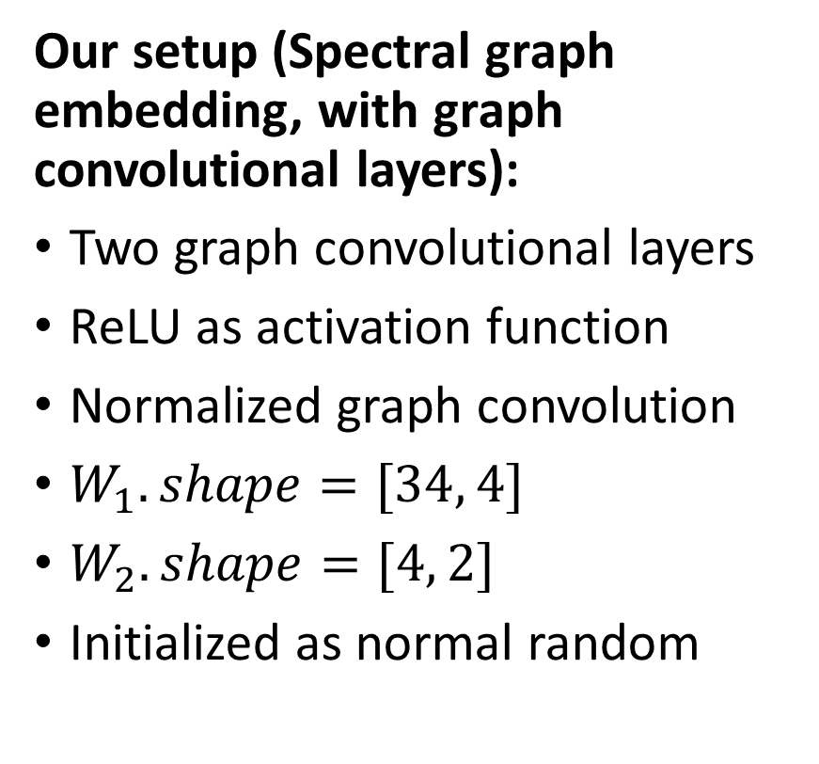
Spectral graph embedding
Our setup (Spectral graph embedding, with graph convolutional layers):
Two graph convolutional layers
ReLU as activation function
Normalized graph convolution
$W_{1}.shape=[34, 4]$
$W_{2}.shape=[4, 2]$
Initialized as normal random

Slide 32


Spectral graph embedding
Our setup (Spectral graph embedding, with graph convolutional layers):
Two graph convolutional layers
ReLU as activation function
Normalized graph convolution
$W_{1}.shape=[34, 4]$
$W_{2}.shape=[4, 2]$
Initialized as normal random

Slide 33

Spectral graph embedding
Spectral graph embedding
Sometimes it works…
(Ready for classification!)

Slide 34


Spectral graph embedding
Spectral graph embedding
Sometimes it works…
(Ready for classification!)
Sometimes it does not.
(Oh crap…)
That’s why you need to train it (and adjust the weights in $W$).

Slide 35

Graph convolutional layer (Kipf)
Definition (graph convolutional layer, with conventional spectral propagation rule):
$$H′=σ\left(\hat{N}HW\right)=σ\left({\hat{D}}^{−1}ÂHW\right)$$
With $σ$ an activation function (so far we used identity), and $W$ a weight matrix, which we will train later on.

Slide 36


Graph convolutional layer (Kipf)
Definition (graph convolutional layer, with conventional spectral propagation rule):
$$H′=σ\left(\hat{N}HW\right)=σ\left({\hat{D}}^{−1}ÂHW\right)$$
With $σ$ an activation function (so far we used identity), and $W$ a weight matrix, which we will train later on.
Definition (graph convolutional layer, with Kipf spectral propagation rule as in the paper [Kipf]):
$$H′=σ\left({\hat{N}}^{kipf}HW\right)$$
$$=σ\left({\hat{D}}^{−\frac{1}{2}}Â{\hat{D}}^{−\frac{1}{2}}HW\right)$$
Slightly better than ${\hat{D}}^{−1}Â$, especially in oriented graphs.
$M={\hat{D}}^{−\frac{1}{2}}Â{\hat{D}}^{−\frac{1}{2}}$ is called the symmetric Laplacian of the graph.
[Kipf] Kipf, T. N., & Welling, M. (2016). Semi-supervised classification with graph convolutional networks.

Slide 37

Graph convolutional layer (Kipf)
Definition (graph convolutional layer, with conventional spectral propagation rule):
$$H=σ\left(\hat{N}XW\right)=σ\left({\hat{D}}^{−1}ÂXW\right)$$
With $σ$ an activation function (so far we used identity), and $W$ a weight matrix, which we will train later on.
Definition (graph convolutional layer, with Kipf spectral propagation rule as in the paper [Kipf]):
$$H=σ\left({\hat{N}}^{kipf}XW\right)$$
$$=σ\left({\hat{D}}^{−\frac{1}{2}}Â{\hat{D}}^{−\frac{1}{2}}XW\right)$$
Slightly better than ${\hat{D}}^{−1}Â$, especially in oriented graphs.
$M={\hat{D}}^{−\frac{1}{2}}Â{\hat{D}}^{−\frac{1}{2}}$ is called the symmetric Laplacian of the graph.
→ Question: why is matrix $M$ more interesting mathematically speaking?
[Kipf] Kipf, T. N., & Welling, M. (2016). Semi-supervised classification with graph convolutional networks.

Slide 38

Graph convolutional layer (Kipf) vs. “Normal” graph convolutional layer
Our “normal” graph convolutional layer
$${\hat{D}}^{−1}ÂH=\sum_{j s.t. \left(i,j\right)∈E}{\frac{h_{j}}{d_{i}+1 }}=\sum_{j=1}^{N}{\frac{h_{j}A_{ij}}{d_{i}+1}}$$
Kipf layer is slightly different, as it no longer amounts to mere averaging of neighboring nodes
$${\hat{D}}^{−\frac{1}{2}}Â{\hat{D}}^{−\frac{1}{2}}H=\sum_{j=1}^{N}{\frac{h_{j}A_{ij}}{\sqrt{d_{i}+1}\sqrt{d_{j}+1}}}$$
Takes into account the degree of neighbors, as extra structural information: helps low-degree neighbors to provide more useful information than high-degree neighbors.

Slide 39

A quick word on Laplacians (out of class)
Definitions (some Laplacians): Given a graph $G$, with adjacency matrix $A$ and degree matrix $D$, we can define the following matrices:
The Laplacian matrix: $L = D − A$
The random walk Laplacian:
$$L_{rw}=I − D^{−1}A=D^{−1}L$$
The symmetric Laplacian:
$$L_{sym}={I −D}^{−\frac{1}{2}}AD^{−\frac{1}{2}}=D^{−\frac{1}{2}}LD^{−\frac{1}{2}}$$
These matrices have interesting math properties in graph theory, but we will leave those to the curious reader.

Slide 40
Why did we use Laplacians for our spectral embedding layers? (intuition, out of class)
Reason: The spectral properties (eigenvalues and eigenvectors) of the Laplacian matrices give interesting insights on the structure and/or connectivity of the graph.
See challenges 1-2-3 on the “normal” Laplacian matrix properties in previous lecture for some examples!
The variations of the Laplacians give different properties (see Lecture Notes with challenge answers given on W10S1 if curious!).
Also, have a look at extra slides for more (out-of-class) discussions on Laplacians and their uses in embedding graphs!

Slide 41
A more sophisticated toy example
Zachary Karate Fight club [ZKC]:
34 members, as nodes, indexed from 1 to 34.
Mr. Hi, the owner is node 1.
The Officer/Trainer is node 34.
All other nodes are members.
Edges define friendships between individuals.
Question: If Mr. Hi and the officer/trainer decide to fight, what will be the teams?
[ZKC] Zachary, W. W. (1977). An information flow model for conflict and fission in small groups.

Slide 42
A more sophisticated toy example
Zachary Karate Fight club [ZKC]:
It consists of a binary classification problem.
Separate the nodes (as with any classification problem).
Need an embedding to represent the graph data, as a matrix/vector of some sort.
→ Graph convolutional layer
[ZKC] Zachary, W. W. (1977). An information flow model for conflict and fission in small groups.

Slide 43

Graph dataset: import and information extraction (nodes, edges, matrices)
We will import our dataset from the networkx library.
Then, we design two functions to extract:
The nodes information (names, features, labels)
The nodes are indexed (0-33), they have no features and have a single label (0 = Mr. Hi, 1 = Officer/Trainer)
The edges are defined as tuples $(i,j)$.
The edges have no features and labels.
We also reconstruct the adjacency matrix and degree matrix.

Slide 44


Slide 45


Slide 46


Slide 47

Graph dataset: import and information extraction (nodes, edges, matrices)
The only nodes with pre-established labels are the nodes 0 and 33.
0 = Mr. Hi, which always gets classified as class 0,
33 = Officer/Trainer, which always gets classified as class 1.
Ground truth labels available for all nodes.
-1 as current class means it is a member and needs to be classified

Slide 48

Building blocks for classifier
Classification task on graph dataset (ZKC).
DL library: Notebooks with implementations on both PyTorch and MXNet (very similar to PyTorch, Tensorflow, etc.)
Note: we are showing this library so you can see that even though multiple libraries exist for DL, they more or less follow the same logic as PyTorch!

Slide 49
Building blocks for classifier
Graph data
$$(A, D, Â, \hat{D}, \hat{N}, H)$$
Graph data
(𝐴, 𝐷, Â, 𝐷 ̂, 𝑁 ̂, 𝐻)
Graph convolutional layer #1
$$H_{1}=σ({\hat{N}}^{kipf}HW_{1})$$
Graph convolutional layer #1
𝐻_1=𝜎(𝑁 ̂^𝑘𝑖𝑝𝑓 𝐻𝑊_1)
Embedding $H_{2}$ for graph data
Embedding 𝐻_2 for graph data
Graph convolutional layer #2
$$H_{2}=σ({\hat{N}}^{kipf}H_{1}W_{2})$$
Graph convolutional layer #2
𝐻_2=𝜎(𝑁 ̂^𝑘𝑖𝑝𝑓 𝐻_1 𝑊_2)
Logistic Regression
Classification task on graph dataset (ZKC).
Model Structure:
2 GCN layers (with Kipf propagation rule)
1 Logistic Regression for classification
emb_model
model

Slide 50


Building a basic GCN layer and model
Create our own custom basic GCN layer block, using the PyTorch nn.Module class as superclass.
Pass the adjacency matrix $A$, compute $Â$, $\hat{D}$, etc.
Propagation rule: $H′=σ\left({\hat{D}}^{−1}\hat{A}HW\right)$

Slide 51



Assembling both GCN layers for embedding
Two basic GCN layers for graph embedding
ReLU as activation function
$W_{1}.shape=[34, 10]$
$W_{2}.shape=[10, 2]$
The layers will progressively decrease the size of the feature vectors from size F, to size 10 and then finally size 2.

Slide 52
Data splitting
All nodes are in the training set.
Note: We do not care about test/val for now, but in practice we should train/test/val split the nodes!
Only Mr. Hi and Officer/Trainer nodes will already have their labels set correctly.

Slide 53


Trainer definition
Define a training function for our GCN + Logistic Regression model.
Loss: Binary Cross Entropy
Optimizer: SGD, with learning rate 0.01 and momentum 1.
Note: no node features for now, making $H = I$, to make these nodes irrelevant in the forward propagation rule!

Slide 54
Train model (no features)
Overall, the model is learning but it takes time to do so properly.
The model attempts to learn from the adjacency matrix and degree matrix only…
It however has no useful nodes features it could rely on.

Slide 55

Train model (no features)
Overall, the model is learning but it takes time to do so properly.
The model attempts to learn from the adjacency matrix and degree matrix only…
It however has no useful nodes features it could rely on.

Slide 56


Building a Kipf GCN layer and model
Similarly, let us create our own custom Kipf GCN layer block, using the PyTorch nn.Module class as superclass.
Pass the adjacency matrix $A$, compute $Â$, $\hat{D}$, etc.
Propagation rule: $H′=σ\left({\hat{D}}^{−\frac{1}{2}}\hat{A}{\hat{D}}^{−\frac{1}{2}}HW\right)$

Slide 57

As before…
Two Kipf GCN layers for graph embedding
ReLU as activation function
$W_{1}.shape=[34, 10]$
$W_{2}.shape=[10, 2]$
The layers will progressively decrease the size of the feature vectors from size F, to size 10 and then finally size 2.

Slide 58


As before…
Define a training function for our GCN + Logistic Regression model.
Loss: Binary Cross Entropy
Optimizer: SGD, with learning rate 0.01 and momentum 1.
Note: no node features for now, making $H = I$, to make these nodes irrelevant in the forward propagation rule!

Slide 59
Train model (no features)
Overall, the model is learning but it takes time to do so properly.
The model attempts to learn from the adjacency matrix and degree matrix only…
It however has no useful nodes features it could rely on.
Kipf formula seems to make the training slightly faster.

Slide 60

Train model (no features)
Overall, the model is learning but it takes time to do so properly.
The model attempts to learn from the adjacency matrix and degree matrix only…
It however has no useful nodes features it could rely on.
Kipf formula seems to make the training slightly faster.

Slide 61
Conclusion
In this lecture
Using graph types datasets
Graph convolutions and graph embeddings
How these convolutions relate to images
Building a Graph Convolutional Neural Network for classification
Training a Graph Convolutional Neural Network
In the next lectures
(Feature Engineering for Graph Convolutional Neural Networks)
Limits of basic approaches
Graph Convolutional Neural Networks with Attention Mechanisms
Some more advanced embeddings
Open questions in Graph Convolutional Neural Networks

Slide 62
Learn more about these topics
Out of class, for those of you who are curious
[TDS] A good article on Graph Theory and typical problems/algorithms with GIF visualizations! https://towardsdatascience.com/10-graph-algorithms-visually-explained-e57faa1336f3
No extra readings for today
(You already have many notebooks to look into!)

Slide 63
Maybe this will not be covered in Lecture 2
But it will be covered in Lecture 3 instead?

Slide 64
Build model: adding nodes features
The nodes have no features.
→ Needs feature engineering
Some interesting features for the nodes would be
the hop-distance to Mr. Hi (i.e. node 0),
and the hop-distance to the officer/trainer (i.e. node 33).
Use a simple BFS to calculate them!

Slide 65

Build model: adding nodes features
The nodes have no features.
→ Needs feature engineering
Some interesting features for the nodes would be
the hop-distance to Mr. Hi (i.e. node 0),
and the hop-distance to the officer/trainer (i.e. node 33).
Use a simple BFS to calculate them!

Slide 66

Build model: adding nodes features
The nodes have no features.
→ Needs feature engineering
Some interesting features for the nodes would be
the hop-distance to Mr. Hi (i.e. node 0),
and the hop-distance to the officer/trainer (i.e. node 33).
Use a simple BFS to calculate them!

Slide 67

Trainer definition
Define a training function for our GCN + Logistic Regression model.
Loss: Binary Cross Entropy
Optimizer: SGD, with learning rate 0.01 and momentum 1.
Note: let us now try with these relevant node features $H_{2}$!

Slide 68

Train model (with some features)
Overall, the model is now able to train properly.
The model attempts to learn from the adjacency matrix and degree matrix only.
The hop-distances carry an information on the proximity of members to Mr. Hi and the Officer/Trainer.

Slide 69

Train model (with some features)
Overall, the model is now able to train properly.
The model attempts to learn from the adjacency matrix and degree matrix only.
The hop-distances carry an information on the proximity of members to Mr. Hi and the Officer/Trainer.

Slide 70


Train model (with some features)
Important message: Additional nodes features make the training much more efficient! Features engineering is key with graphs!

Slide 71
Additional features?
We could think of additional features to help the Graph Convolutional Neural Network learn. For instance:
Additional node features: for instance, number of close friends to Mr. Hi and Officer/Trainer among the neighbors of the node (close friends = nodes with hop-distance of 1).
Edge features: for instance, add a random “Friendship” value to the edges, that quantifies friendship between two nodes. Open question: Later on, how would you modify your propagation formulas to take into account the edge weights?
Challenge: Leaving the implementation of these extra features as challenge for you to practice!

Slide 72


Why did we use Laplacians for our spectral embedding layers? (intuition, out of class)
Embedding as a minimization problem: a “good” embedding
$$∀i∈\left[1,N\right], p_{i}: h_{i}∈ℝ^{F}→ v_{i}∈ℝ^{F^{′}}$$
Encodes nodes features $h_{i}$ into vectors $v_{i}$, such that connected nodes stay as close a possible.
A “good” embedding matrix
$$P = [p_{1}(h_{1}),…, p_{N}(h_{N})]$$
is obtained through the following minimization
$$\min_{P}\left[\sum_{i=1}^{N}{\sum_{j=1}^{N}{{\left(p_{i}\left(h_{i}\right) −p_{j}\left(h_{j}\right)\right)}^{2}}}\right]$$
Which is equivalent to $$\min_{P}\left[P^{T}LP\right],$$
$$with P^{T}P=I and P^{T}I=0$$

Slide 73


Why did we use Laplacians for our spectral embedding layers? (intuition, out of class)
Embedding as a minimization problem: a “good” embedding
$$∀i∈\left[1,N\right], p_{i}: h_{i}∈ℝ^{F}→ v_{i}∈ℝ^{F^{′}}$$
Encodes nodes features $h_{i}$ into vectors $v_{i}$, such that connected nodes stay as close a possible.
This embedding is solution to
$$\min_{P}\left[P^{T}LP\right],$$
$$with P^{T}P=I and P^{T}I=0$$
Solution: The solution is provided by the matrix of eigenvectors corresponding to the $F^{’}$ lowest non-zero eigenvalues of the eigenvalue problem
$LP=λP$

Slide 74

Why did we use Laplacians for our spectral embedding layers? (intuition, out of class)
Using the random walk Laplacian $L_{rw}$, instead of the “normal” Laplacian adds a normalization factor to the embedding.
Using the symmetric Laplacian $L_{sym}$, instead of the “normal” Laplacian adds a normalization factor + accounts for neighboring nodes in the embedding.
If you are curious, find more details (mathematical foundations behind embedding problems, proofs, applications, etc.)
UC San Diego lecture (more specifically, slides 14-end): https://cse291-i.github.io/WI18/LectureSlides/L14_GraphLaplacian.pdf

